Slide 1
Becoming the Expert -
Interactive Multi-Class Machine Teaching
CVPR2015
Edward Johns, Oisin Mac Aodha, Gabriel J. Brostow
University College London
http://visual.cs.ucl.ac.uk/pubs/interactiveMachineTeaching

Slide 2
Propose an Interactive Machine Teaching algorithm enableing a computer to teach to a human challenging visual concepts, which are multi-class image classification tasks in this paper

Slide 3
Machine Teaching by Jerry Zhu in WISC
http://pages.cs.wisc.edu/~jerryzhu/machineteaching/
If machine learning is to discover knowledge, machine teaching is to pass it on
Given a learning algorithm and a target model, machine teaching finds an optimal(e.g. the smallest) training set
Machine teaching aims to maximally influence the learner via optimal training data

Slide 4
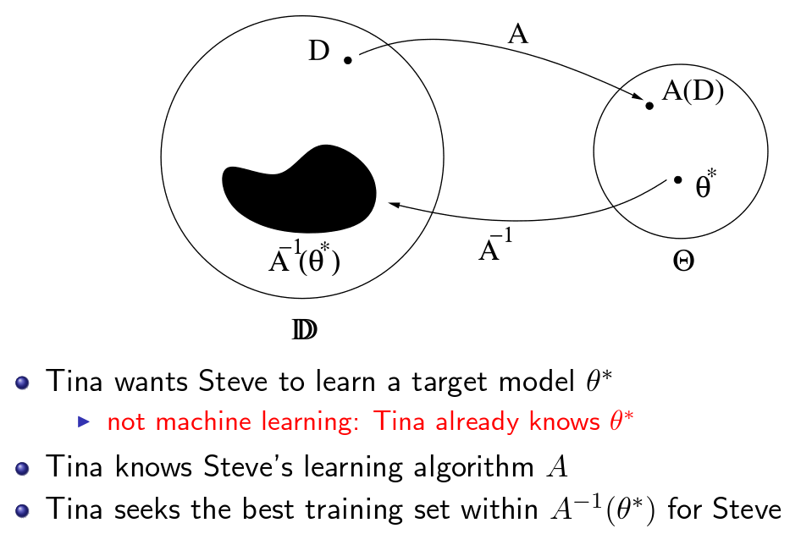
Machine Teaching by Jerry Zhu in WISC
http://pages.cs.wisc.edu/~jerryzhu/machineteaching/

Slide 5
Difference with Adaptive Learning
Adaptive learning
Learn more accurate models given the smallest amount of supervision
Select the most informative datapoints to be labeled by the human
Machine teaching
Treat human brain like a black box
Optimize the teaching set

Slide 6
Two areas in Machine Teaching
Batch(fixed) teaching
Construct an optimal teaching set offline
Order of teaching set is fixed
Assume students have perfect memory and same learning ability
Examples
Srnd : Random choose teaching image to present
Sbatch : Opimal teaching set offline with fixed order

Slide 7
Two areas in Machine Teaching
Interactive/Adaptive/Online teaching
Students have different learning rates
Teacher receives feedback as teaching progresses
Teacher can adapt to the current ability of each individual student
Examples
Swp : Select the worst-predicted example and provide to the learner
Scc : Compute the feature space centroids for each class and the learner is only presented with the images represented by centroids

Slide 8
Modeling the student
Dt : current teaching set
Du : unobserved images set
Approximate the student’s conditional distribution given Dt
Propagate the student’s estimate of class labels for Dt to Du by defining a similarity matrix W
Obtain the student’s conditional distribution on Du

Slide 9
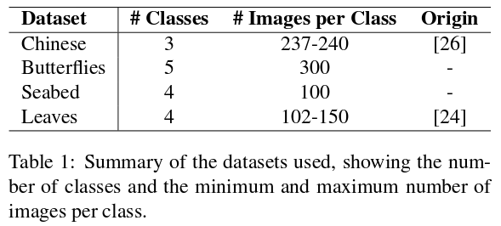
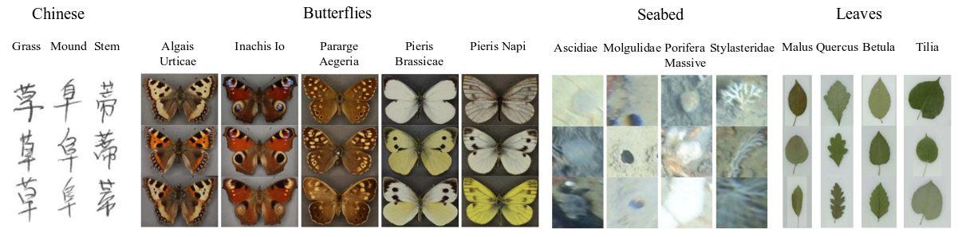
Datasets
Four datasets
Principle of choosing datasets:
Small inter-class variation
Large intra-class variation

Slide 10
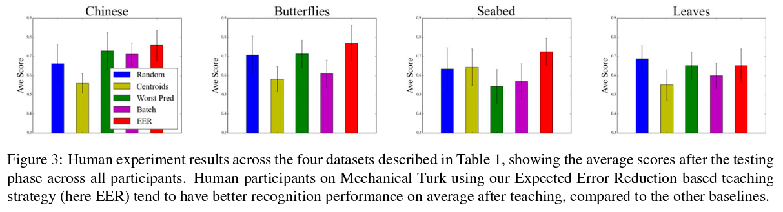
Experimental Results
Joint second on ‘Leaves’
Multi-modal nature of the leaves present
Human learners typically assumed unimodal distribution

Slide 11
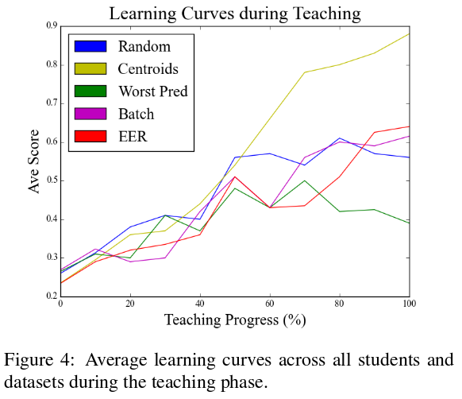
Experimental Results
Not equivalent to true learning curve
Scc : false sense of performance because of the repeatedly shown centroid.
Swp : relatively flat learning curve, because the outlier images are challenging to learn.
Srnd, Sbatch : Unable to adapt to the student’s ability

Slide 12
Summary
Contribute a lot expecially in online education and HCI
Realise automatic learning despite human intervention
Reduce learning time because of targeted teaching
Provide a web based interface and framework for exploring new teaching strategies (BUT it can’t work right now because disk is full)

Slide 13
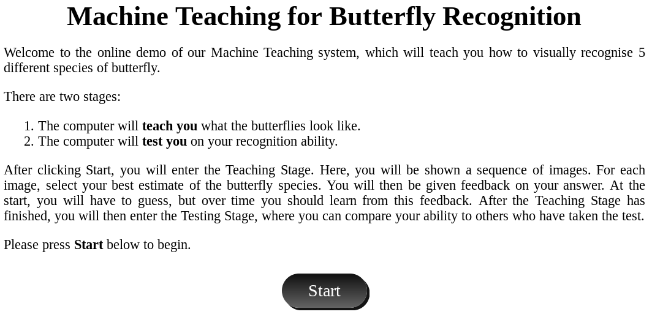

Slide 14
Thank you.

